Slide 1
Q|R – Quantum Refinement: progress update Jan 15-Mar 24, 2016
Pavel Afonine
Mark Waller
Min Zheng
March 25th, 2016
ICQMS, Shanghai University, PR China

Slide 2
Refinement in a nutshell
Refinement - optimization of T w.r.t. model parameters:
From diffraction experiment
From crystal structure model
External “a priori” information about the problem

Slide 3
Refinement in a nutshell
Refinement - optimization of T w.r.t. model parameters:
From diffraction experiment
From crystal structure model
External “a priori” information about the problem
Primary
Secondary
We want to fit model to data as good as possible without violating available “a priori” knowledge

Slide 4
Refinement in a nutshell
Refinement - optimization of T w.r.t. model parameters:
T_{RESTRAINTS} = T_{BOND} + T_{ANGLE} + T_{DIHEDRAL} + T_{PLANARITY} + T_{NONBONDED}+ T_{CHIRALITY}
T_{BOND} = Σ_{all bonded pairs}w(d_{ideal} - d_{model})² , T_{ANGLE} = …, …
We call it geometry restraints…
… also known as potential function, energy term, force field etc.

Slide 5
Refinement in a nutshell
Refinement - optimization of T w.r.t. model parameters:
T_{RESTRAINTS} = T_{BOND} + T_{ANGLE} + T_{DIHEDRAL} + T_{PLANARITY} + T_{NONBONDED}+ T_{CHIRALITY}
T_{BOND} = Σ_{all bonded pairs}w(d_{ideal} - d_{model})² , T_{ANGLE} = …, …
Geometry restraints are too simple to provide comprehensive information about chemistry.

Slide 6
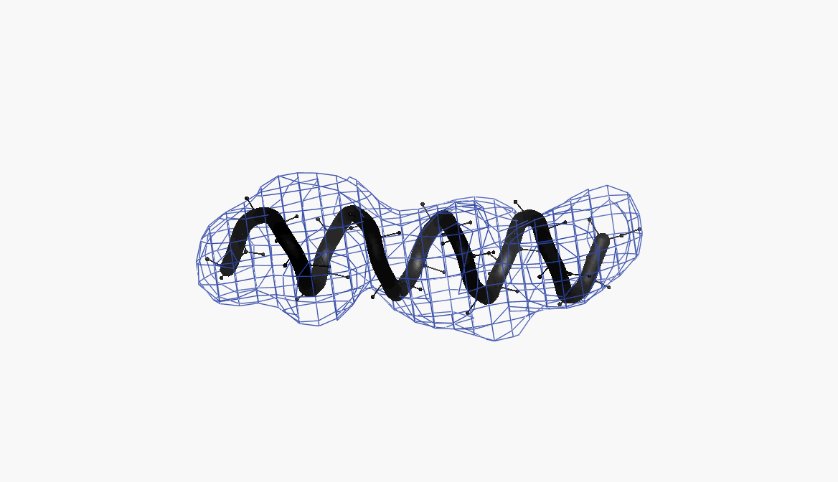
Refinement in a nutshell
Example: Refinement of perfect α-helix against low-resolution data
Standard restraints are insufficient
Helix geometry deteriorates during refinement
More information (than standard restraints) is needed to make refinement meaningful

Slide 7
QR (Quantum Refinement)
Refinement - optimization of T w.r.t. model parameters:
T_{RESTRAINTS} = T_{BOND} + T_{ANGLE} + T_{DIHEDRAL} + T_{PLANARITY} + T_{NONBONDED}+ T_{CHIRALITY}
Information arising from QM calculations
Replace standard geometry restrains with those arising from QM calculations

Slide 8
Approach: what’s available
Phenix software suite
Jeff’s suite of programs
3rd party QM packages
Vast expertize in:
Theoretical chemistry (ICQMS)
Professional software development (Phenix)
Crystallography for protein structure solution (Phenix)

Slide 9
Phenix – large scale collaboration

Slide 10
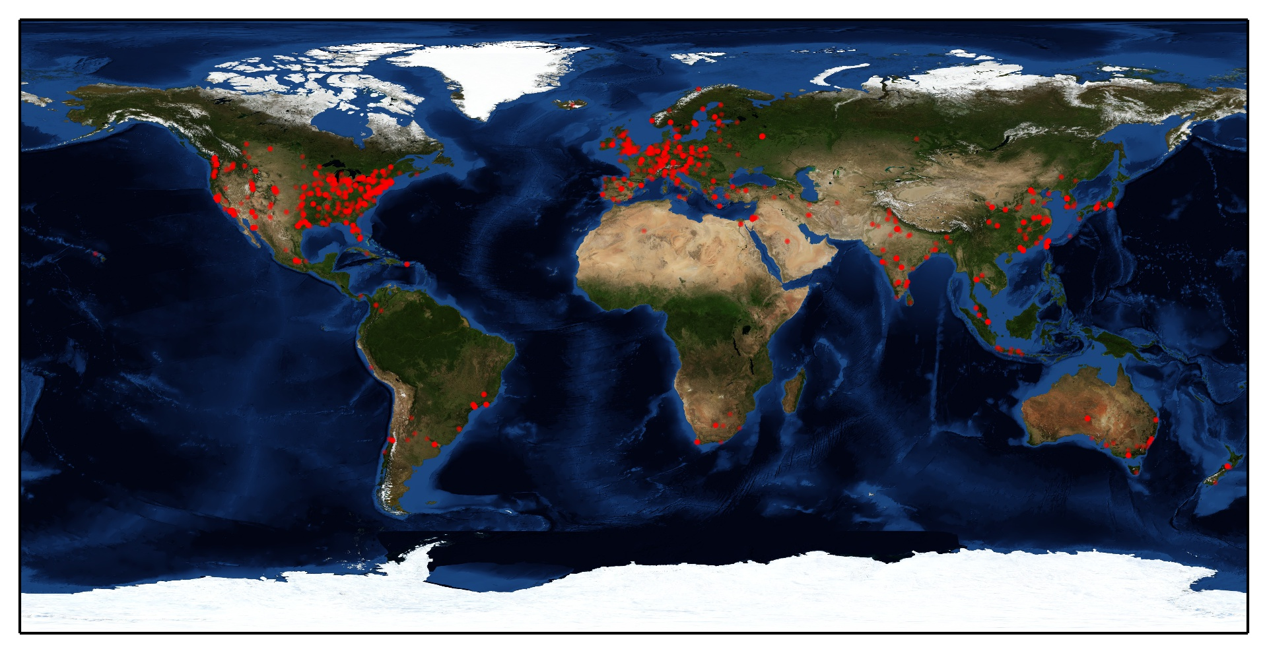
Phenix – quick facts
Phenix publications: 157
Publications citing Phenix: 7263
Registered Users: 20008
Registered Locations: 2142
Registered Locations: 2142
Source: www.phenix-online.org

Slide 11
Mixing all together
Phenix software suite
QM resources
Theoretical chemistry (ICQMS)
Professional software development (Phenix)
Crystallography for protein structure solution (Phenix)

Slide 12
Mixing all together
Phenix software suite
QM resources
Modify Phenix to incorporate all necessary changes?

Slide 13
Mixing all together
Phenix software suite
QM resources
Modify Phenix to incorporate all necessary changes?
Great global goal
Requires a lot of team work for a long period of time

Slide 14
Mixing all together
Modify Phenix to incorporate all necessary changes?
Impractical as a short-term goal:
Phenix is…
…too large (7.5Gb)
…too agile (new version every night)
Not all required software is…
…plug-and-play:
3rd party (license restrictions)
Language barriers
Phenix: C++/Python, nothing else allowed
…readily available:
New developments may require years of team work
Can’t push back ad hoc changes in local copy
✗

Slide 15
Mixing all together
Create new project based on Phenix libraries:
Light-weight initial implementation
Idea and proof-of-concept testing platform
Easy to maintain
No strict policies that may hinder experimenting
Version control
Open to anyone
Phenix software suite
QM resources
Q|R – quantum refinement
Refinement tools using CCTBX library
Bridge between Q|R and QM software
QM software (3rd party at present

Slide 16

State-of-the-art: Q|R project at GitHub

Slide 17
Q|R project
Major code contributors so far:
Mark Waller
Min Zheng
Pavel Afonine
… others are warmly encouraged to participate!

Slide 18
Constructing test system
Self-consistent system with known answer:
Choose reference model (THE answer)
Simulate (compute) “experimental” data from it
Perturb reference model in many different ways
Refine perturbed models
See how refined model match the answer model
Use this to rank and optimize refinement tools

Slide 19
Constructing test system - Goals
Test software and tools:
Find bugs, corner cases, inefficiencies
Get ideas about:
Convergence radius
Runtimes
Overall feasibility

Slide 20
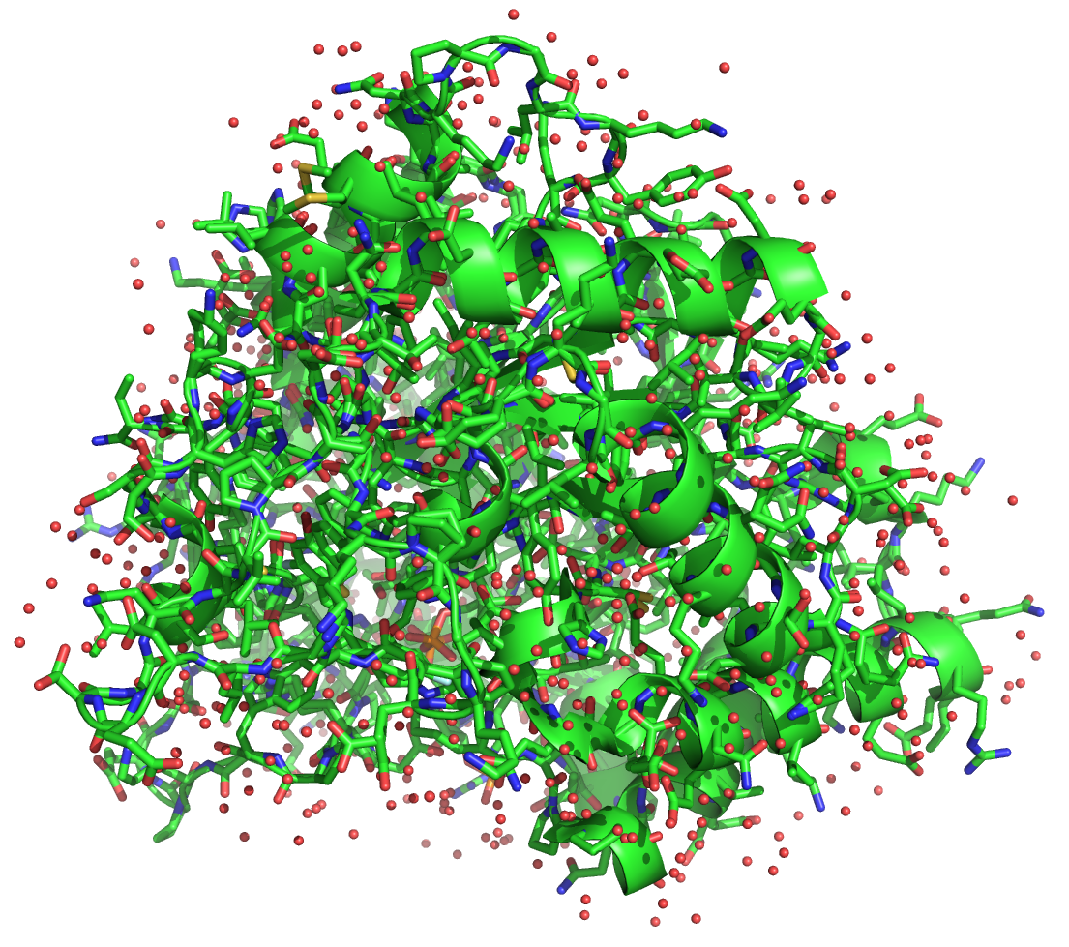
Constructing test system
Aldose Reductase model:
PDB code: 1US0
Resolution: 0.66 Å

Slide 21
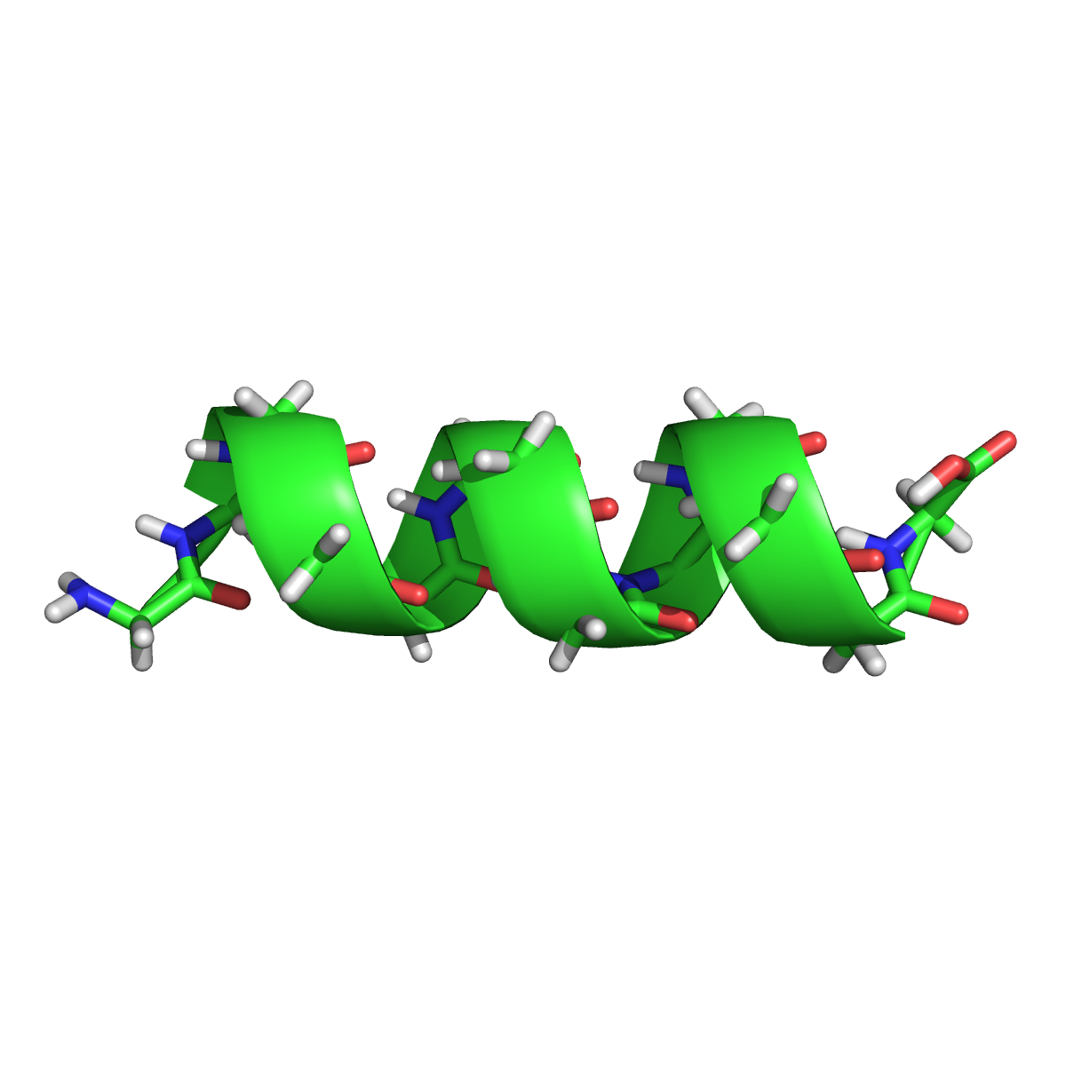
Constructing test system
Carve out well resolved in electron density map helix:
A87-99
Convert to poly-GLY to speedup calculations
Add H (“neutron” longer X-H distances)

Slide 22
Constructing test system
Consider…
… as a reference and simulate (calculate) structure factors from it (Fobs)

Slide 23
Constructing test system
Consider…
… as a reference and calculate a set of perturbed models with different perturbation dose introduced into coordinates

Slide 24
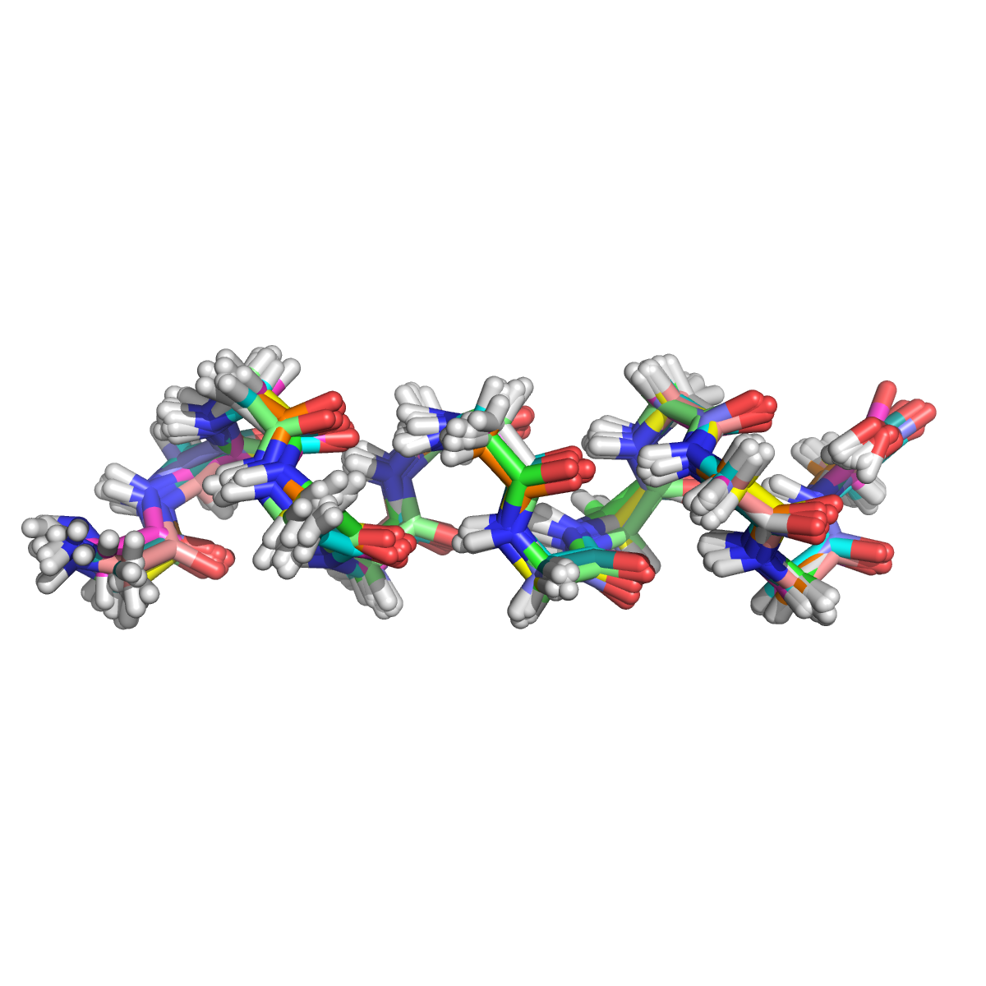
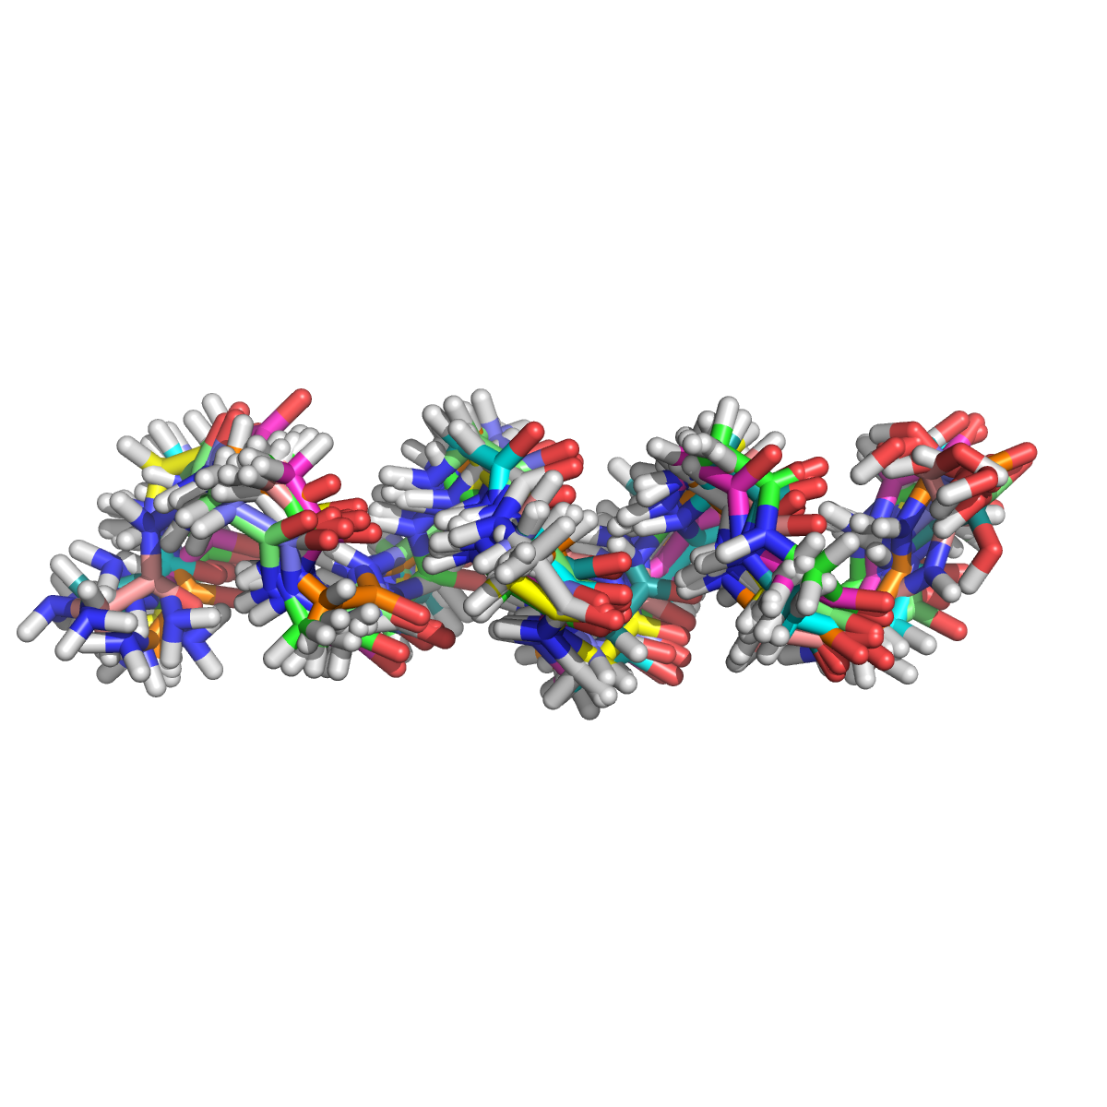
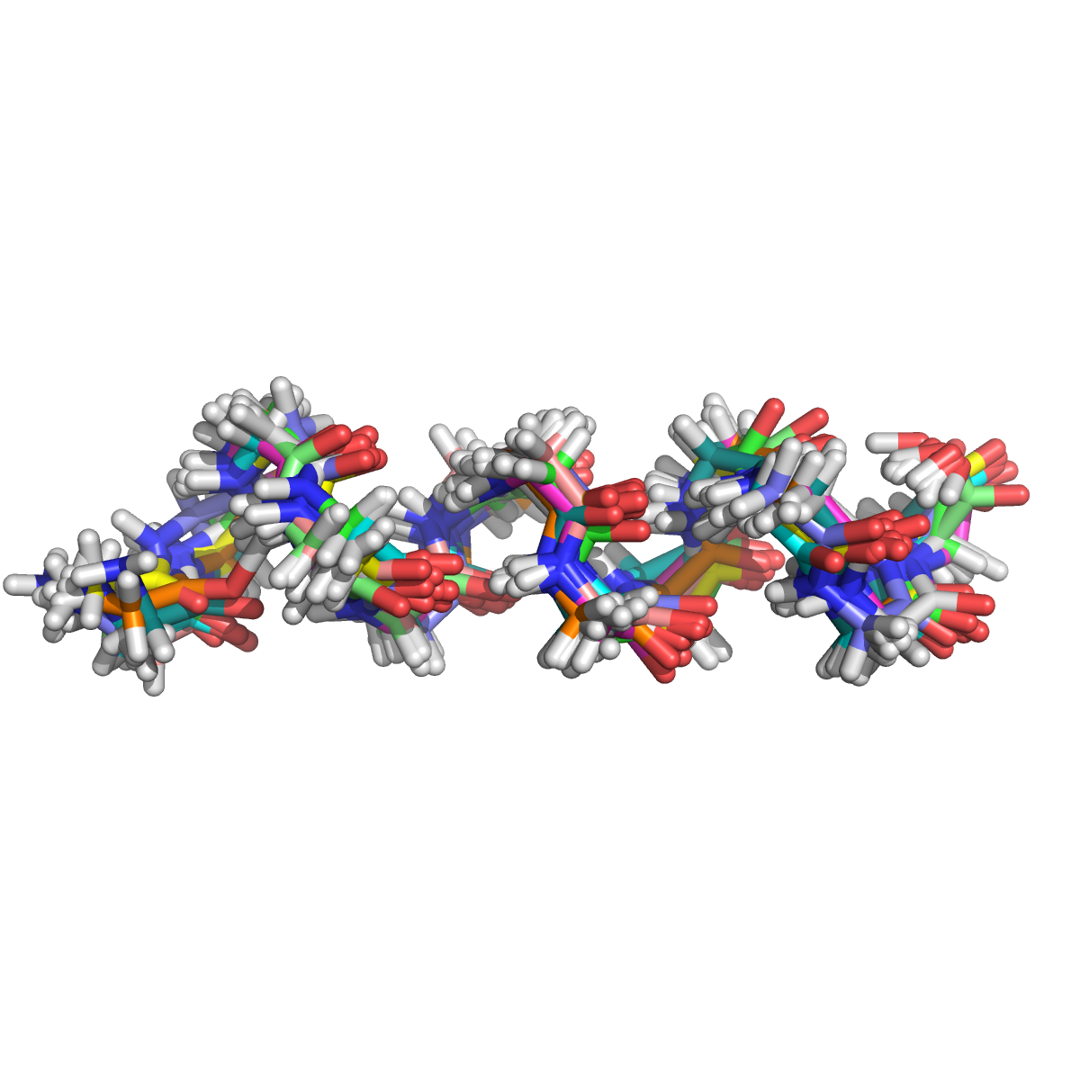
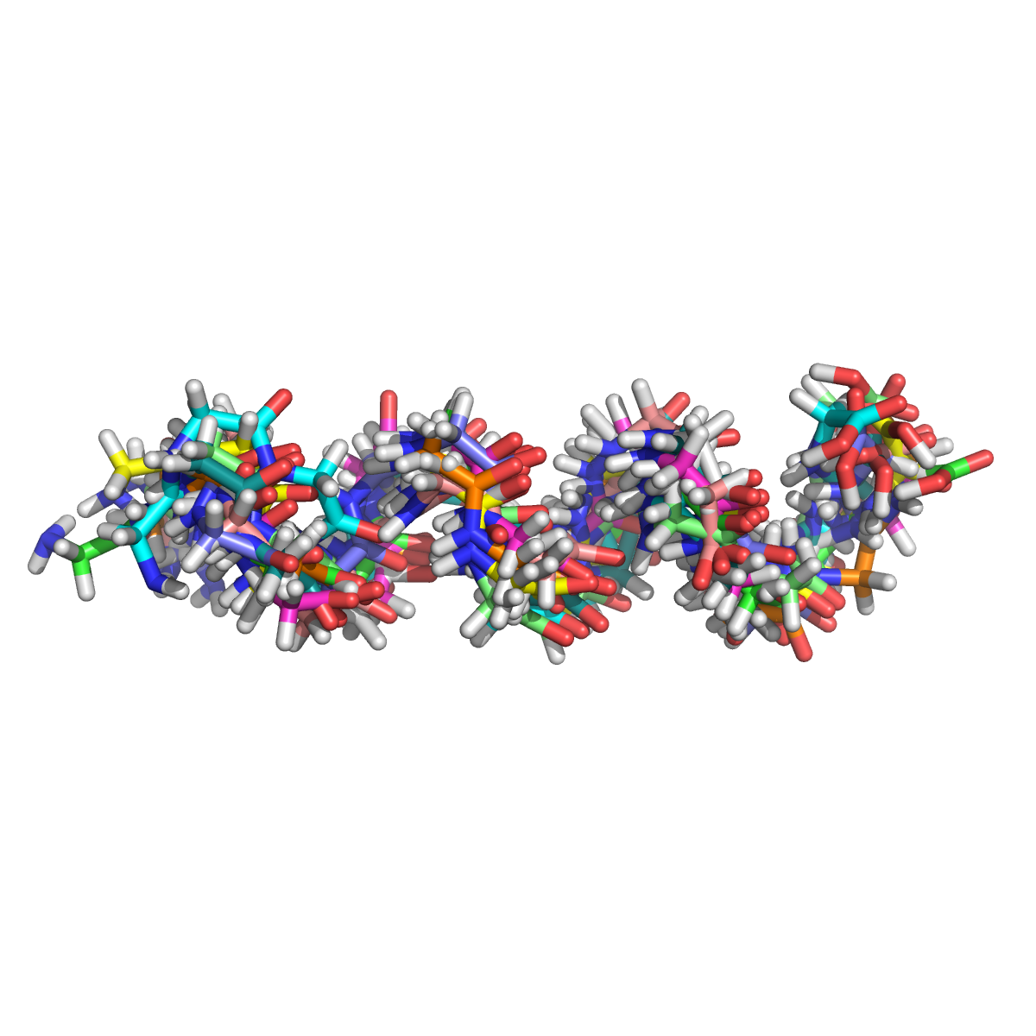
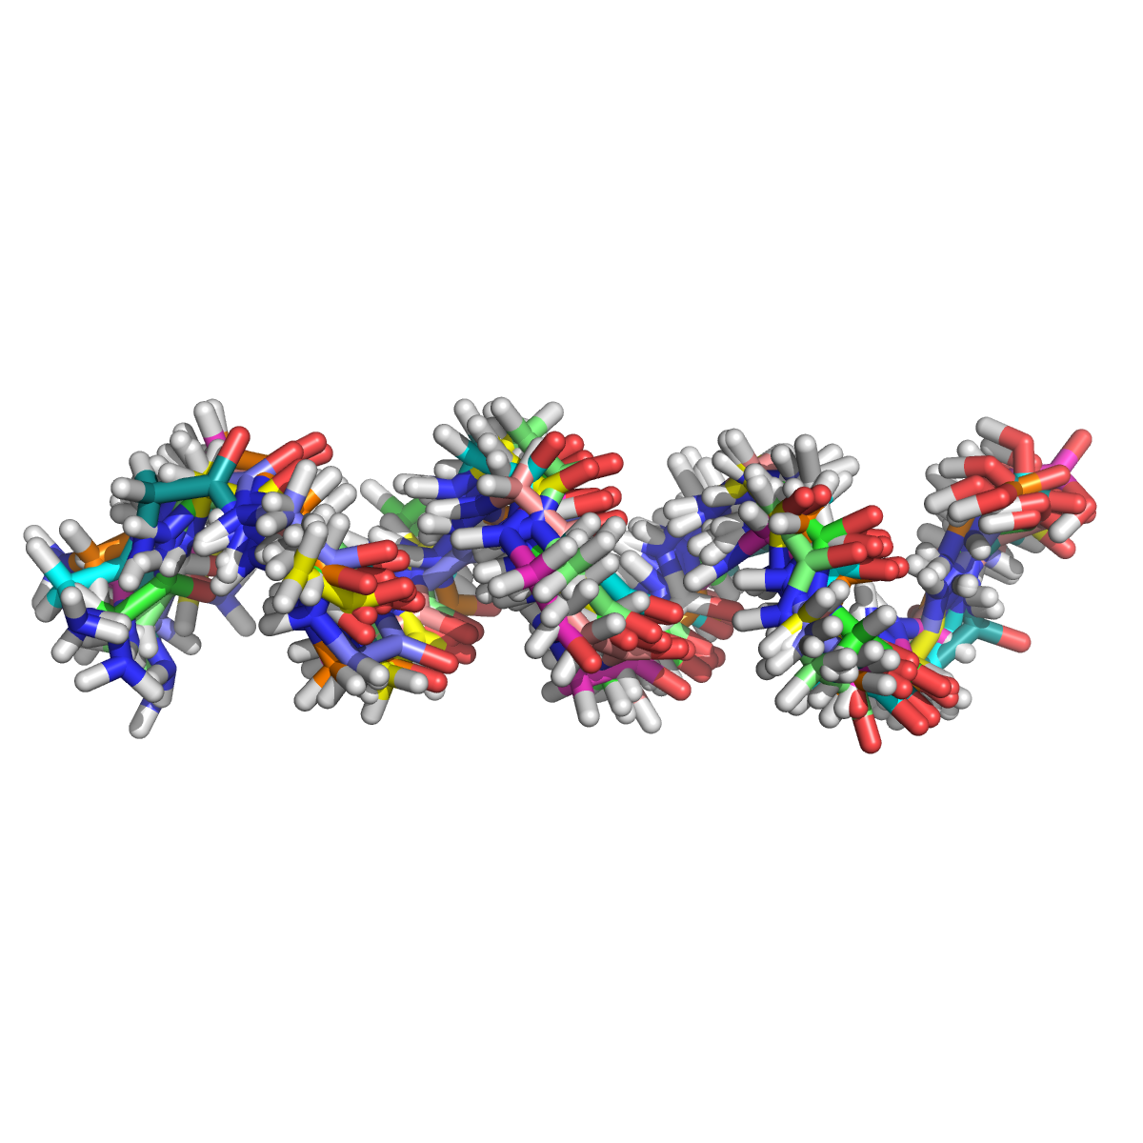
Constructing test system
5 sets of perturbed models: 0.3, 0.6, 0.9, 1.2, 1.5 Å
10 models in each set, 50 models total

Slide 25
Refinement and pure optimization
For each model…
…Do:
Optimization
QM (Mopac)
Phenix
Refinement
QM (Mopac)
Phenix

Slide 26
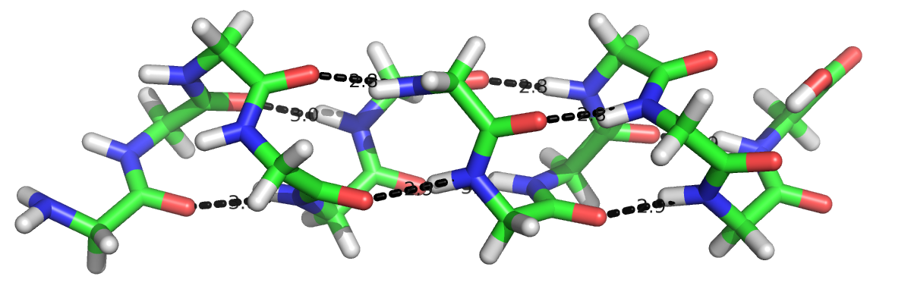
Assessing results
We know how many H-bonds are in reference model …
… we can calculate how many H-bonds survived perturbation:
Perturbation amount (Å) | Percentage of H conserved
0.3 | 60
0.6 | 34
0.9 | 14
1.2 | 10
1.5 | 3

Slide 27
Results
Phenix optimization:
Perturbation amount (Å) | Percentage of H conserved
0.3 | 54
0.6 | 32
0.9 | 20
1.2 | 9
1.5 | 3
QM optimization:
Perturbation amount (Å) | Percentage of H conserved
0.3 | 90
0.6 | 73
0.9 | 54
1.2 | 38
1.5 | 26

Slide 28
Results
Phenix refinement:
Perturbation amount (Å) | Percentage of H conserved
0.3 | 8
0.6 | 7
0.9 | 10
1.2 | 5
1.5 | N/A
QM refinement:
Perturbation amount (Å) | Percentage of H conserved
0.3 | 19
0.6 | 13
0.9 | 6
1.2 | 9
1.5 | N/A

Slide 29
Results – Question
QM optimization:
Perturbation amount (Å) | Percentage of H conserved
0.3 | 90
0.6 | 73
0.9 | 54
1.2 | 38
1.5 | 26
QM refinement:
Perturbation amount (Å) | Percentage of H conserved
0.3 | 19
0.6 | 13
0.9 | 6
1.2 | 9
1.5 | N/A
Why refinement looses so many H-bonds?

